Slide 2
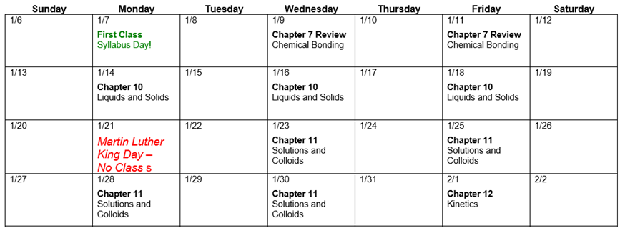
HW for CH 7
Due at 11:59 pm
5 days down, 39 to go
No Class on Monday!
Homework for Chapter 7 due Friday 1/25

Slide 4
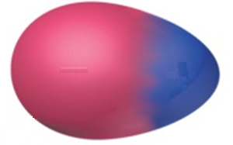
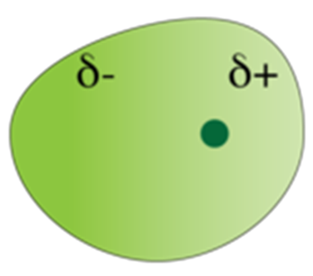
Strength of Intermolecular Forces
ion-dipole
dipole-dipole
hydrogen bonding
Induced/instantaneous dipole:
ion-induced dipole
dipole-induced dipole
instantaneous dipole-induced dipole
(40-600 kJ/mol)
(5-25 kJ/mol)
X
H
…
X
(10-40 kJ/mol)
(5-15 kJ/mol)
(2-10 kJ/mol)
(0.05-40 kJ/mol)

Slide 5
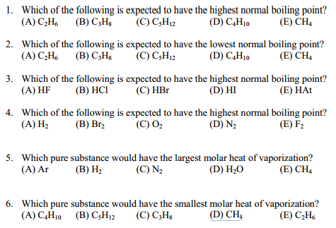
Strength of Intermolecular Forces
Intermolecular Forces general correlate with boiling point.
greater force = higher boiling point

Slide 7
Properties of liquids
Boiling point
Surface Tension
intermolecular forces at liquid-air interface
Capillary Action
competition between intermolecular forces
Viscosity
strength of intermolecular forces

Slide 8
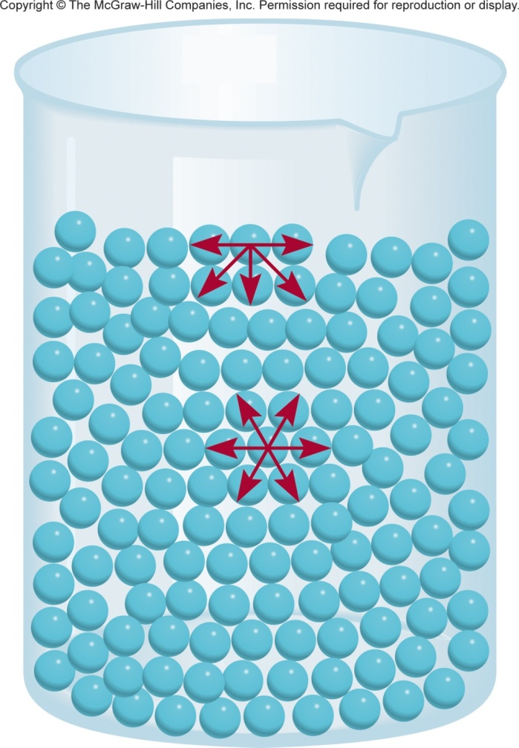
Surface Tension
Surface tension is the amount of energy required to stretch or increase the surface of a liquid by a unit area (N/m).
The surface molecules have higher energy than the interior molecules.
That’s why liquids tend to minimize their surface and form droplets.
Surface tension is a measure of attractive forces acting at the surface of a liquid.
The molecules at the surface are attracted unevenly.

Slide 9
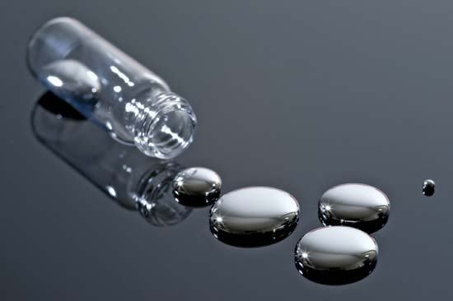
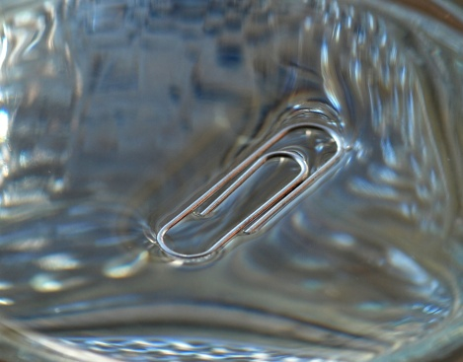
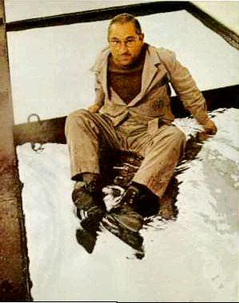
Surface Tension
Water
Mercury
Not just surface tension but still cool.

Slide 10
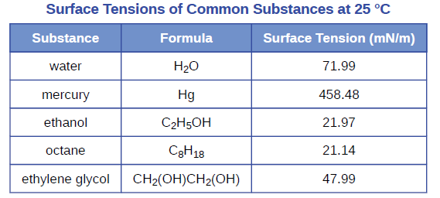
Surface Tension
Stronger intermolecular forces = greater surface tension.

Slide 11
Surface Tension
propylene glycol mixed with water (+Food coloring)
Manu Prakash and coworkers at
Stanford University
Differences in surface tension dictate mixing.

Slide 12
Properties of liquids
Boiling point
Surface Tension
intermolecular forces at liquid-air interface
Capillary Action
competition between intermolecular forces
Viscosity
strength of intermolecular forces

Slide 13
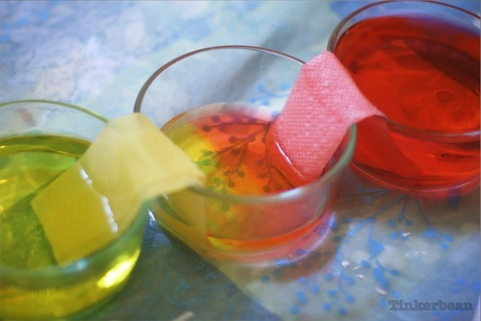
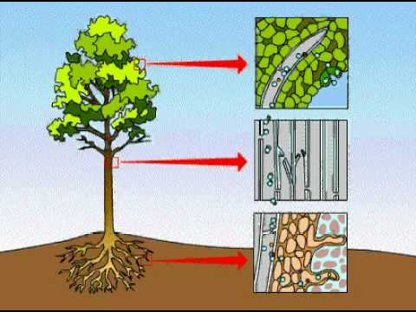
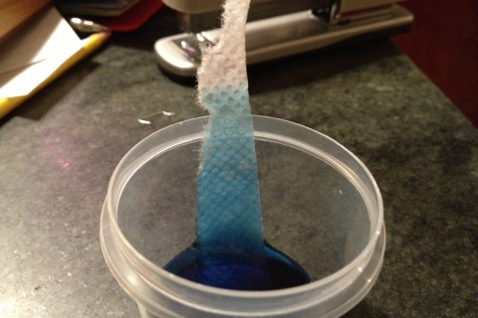
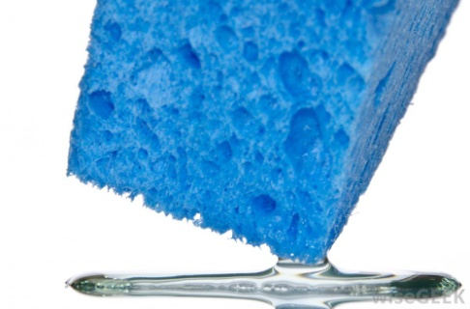
Capillary Action
Capillary action (sometimes capillarity, capillary motion, or wicking) is the ability of a liquid to flow in narrow spaces without the assistance of, and in opposition to, external forces like gravity.

Slide 14
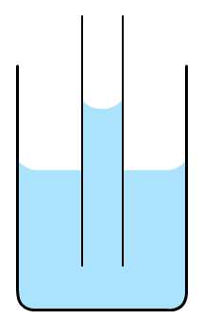
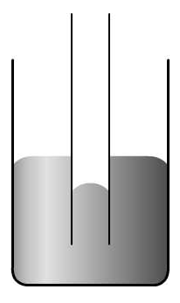
Forces Involved in the Capillary Action
Cohesive forces are the forces that hold liquids together (intermolecular forces).
Adhesive forces are the forces between a liquid and another surface (intermolecular forces).
Adhesive forces > cohesive forces
Adhesive forces < cohesive forces
Capillary rise.
Capillary fall.

Slide 15
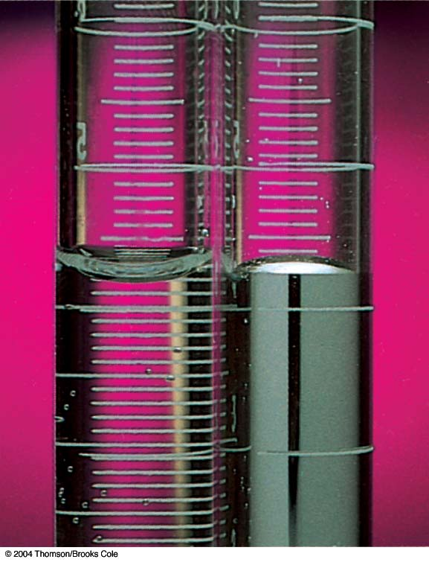
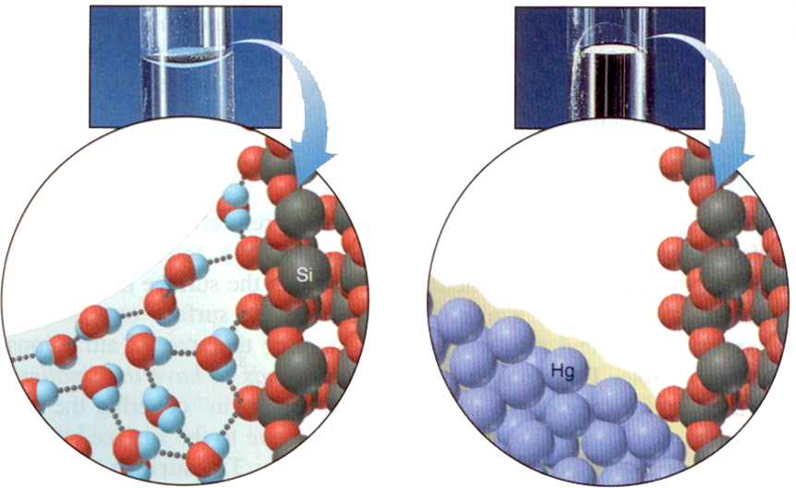
Capillary Action
Water
Concave meniscus
Mercury:
Convex meniscus
adhesive forces > cohesive forces
adhesive forces < cohesive forces

Slide 16
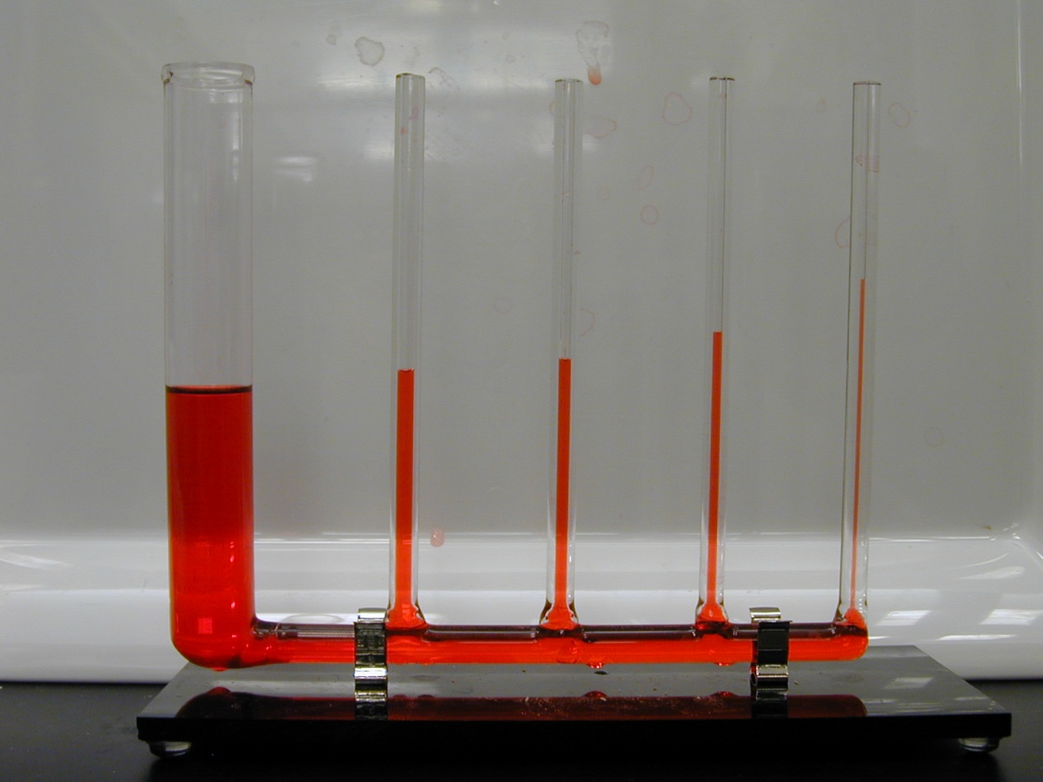
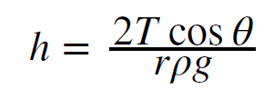
Capillary Action
h = height of the liquid
T = surface tension
Θ = the contact angle
r = the radius
ρ = the density
g = gravity (9.8 m/s²)
Smaller diameter, higher the climb.
Volume (gravity) vs. Surface area (adhesion)

Slide 17
Properties of liquids
Boiling point
Surface Tension
intermolecular forces at liquid-air interface
Capillary Action
competition between intermolecular forces
Viscosity
strength of intermolecular forces

Slide 18
Viscosity
Viscosity is the resistance of a liquid to flow.
water is less viscous than syrup or honey.
Tthe ease with which molecules can move past each other.
Decreases with increasing temperature.
Viscosity depends on intermolecular forces and on the shape of molecules.
Liquids with small spherical molecules are less viscous than liquids with long molecules that can become entangled and have high surface area.

Slide 19
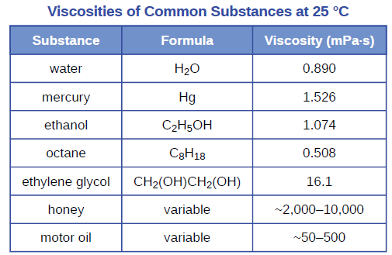
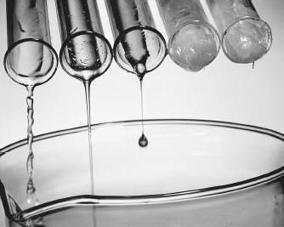
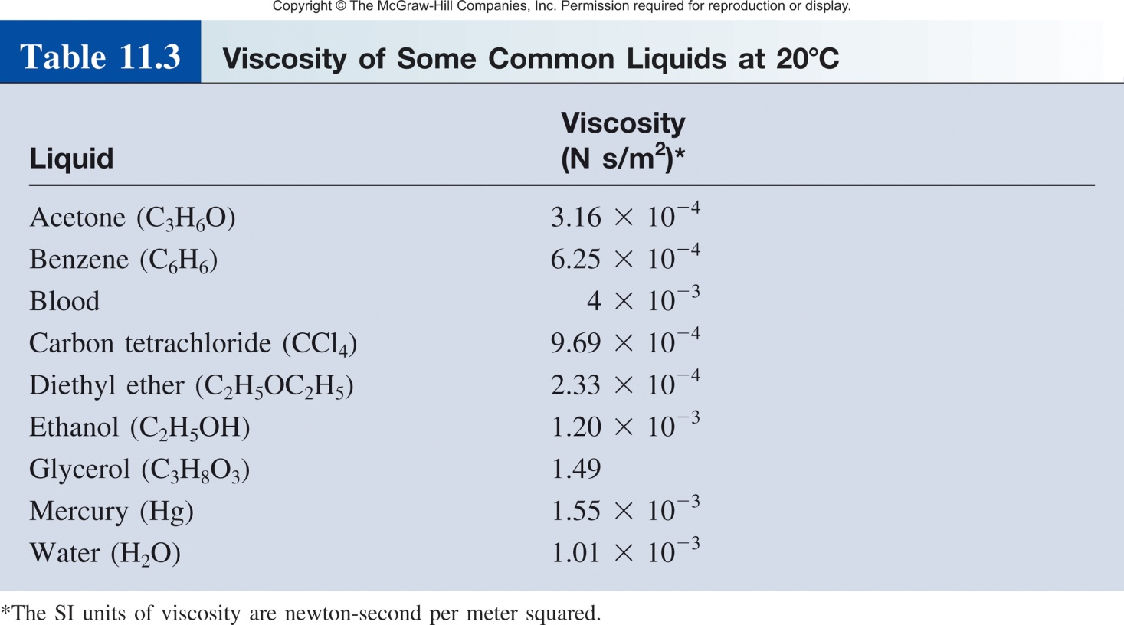
Viscosity
Low Viscosity
High Viscosity
Strong intermolecular forces
= higher viscosity

Slide 20
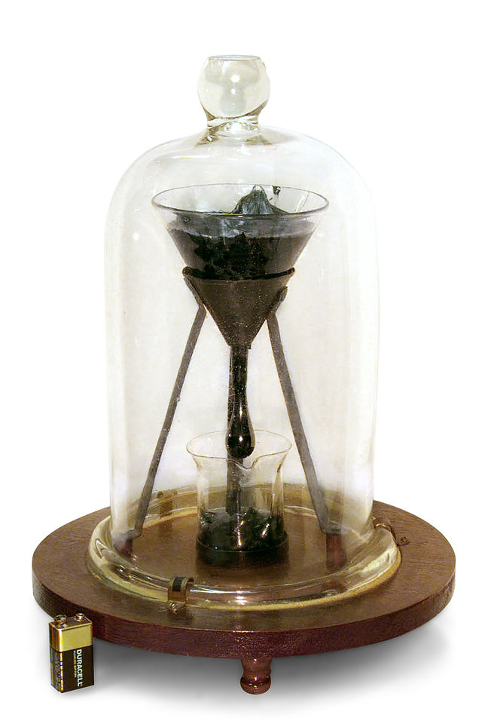
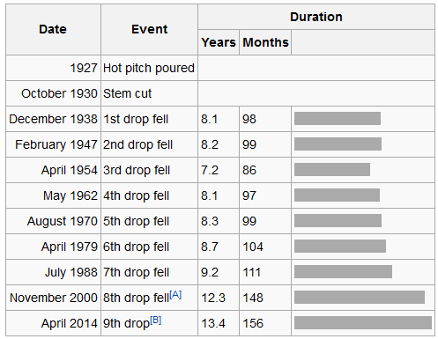
Viscosity
Pitch Drop “Experiment”
Started in 1927
by Professor Thomas Parnell
University of Queensland in Australia
Worlds longest experiment
9th drop fell April 17th, 2014
https://www.youtube.com/watch?v=BZvsrOciU_Q
http://www.thetenthwatch.com/

Slide 21
Properties of liquids
Boiling point
Surface Tension
Capillary Action
Viscosity
Strong intermolecular forces = higher boiling point
Strong intermolecular forces = higher surface tension
Competition between cohesive and adhesive intermolecular forces
Strong intermolecular forces = higher viscosity

Slide 23
STATES OF MATTER
CH 10.5-6
CH 10.1-2
CH 9
Physics?
The internet?
Phase Change (CH 10.3-4)
The transformation from one phase to another upon the addition or release of energy.

Slide 24
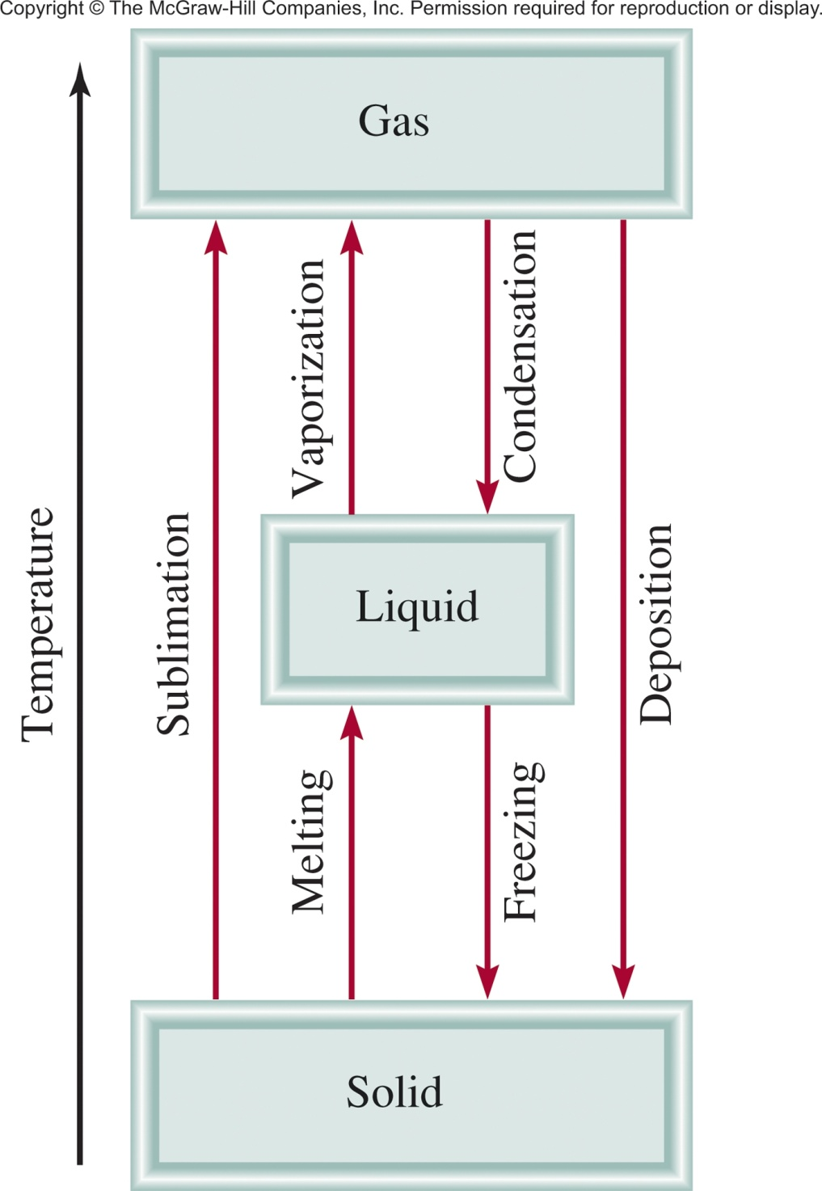
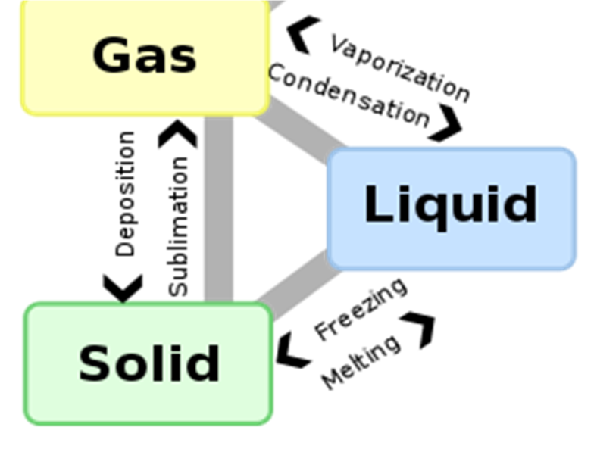
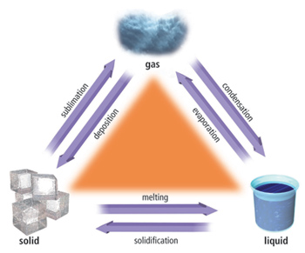
Phase Changes
Least
Order
Most
Order

Slide 25
Phase Changes
Least
Order
Outline
Liquid ↔ Gas
Solid ↔ Liquid
Solid ↔ Gas
Most
Order

Slide 26
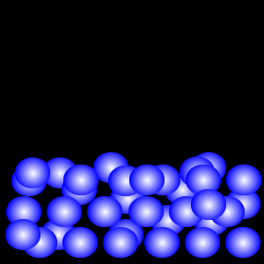
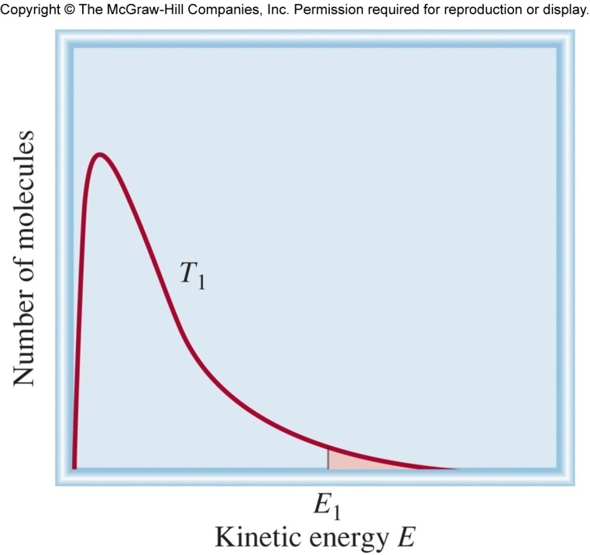
Liquid ↔ Gas
Kinetic energy of molecules.
“slow” molecules
“fast” molecules
Some molecules are fast enough to escape intermolecular forces.

Slide 27
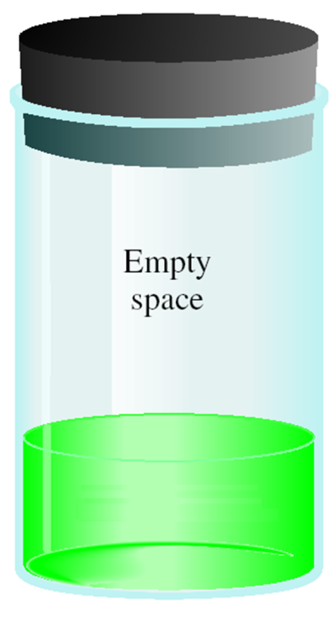
Liquid ↔ Gas
Liquid
At time = 0
At time > 0
At time = ∞
At equilibrium!
# of molecules in =
# of molecules out
rate of evaporation =
rate of condensation

Slide 28
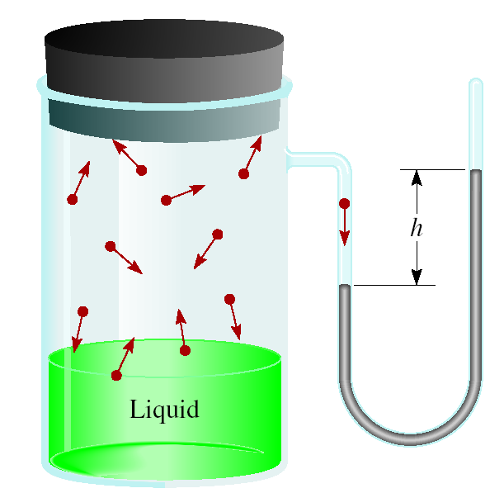
Liquid ↔ Gas
Molecular motion causes force.
Force creates pressure.
We can measure the pressure.
Vapor pressure (VP)- is the pressure exerted by a vapor in equilibrium with its condensed phases (solid or liquid) at a given temperature in a closed system.
# of molecules in =
# of molecules out
rate of evaporation =
rate of condensation
At a given temperature:
Weaker intermolecular forces =
more molecules out =
higher vapor pressure
Vapor pressure is temperature dependent!

Slide 29
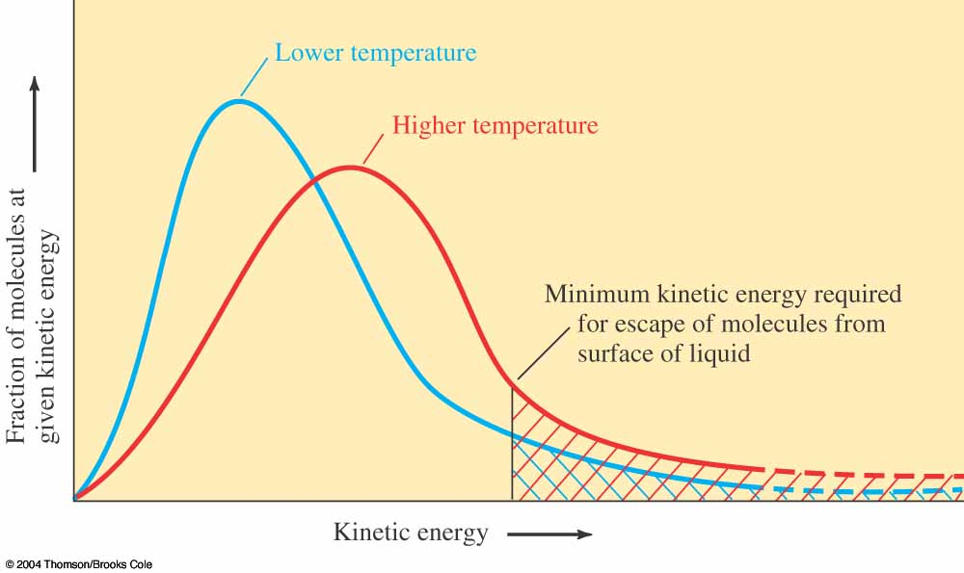
Liquid ↔ Gas
Vapor pressure is temperature dependent!
Lower T =
Lower P
Higher temperature (T) =
higher average kinetic energy =
more molecules escaping solution =
higher vapor pressure (P)
Higher T =
Higher P

Slide 30
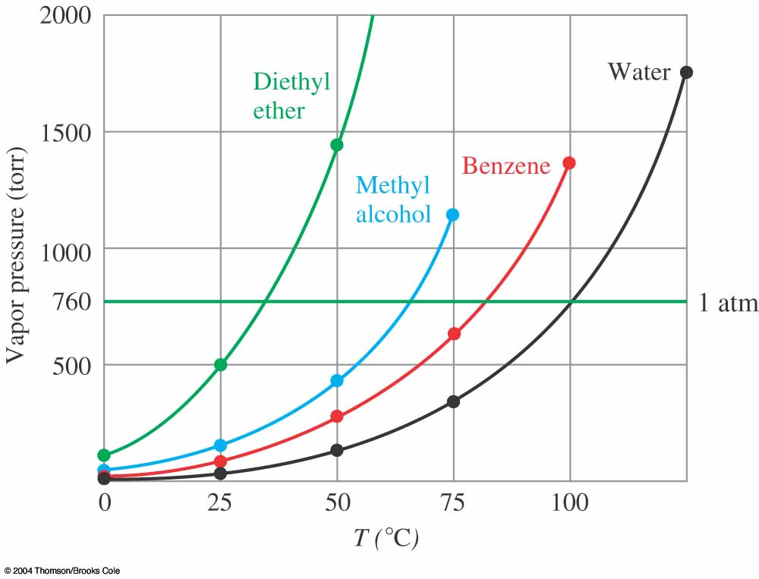
Relationship Between T and P
The experiment-
Close container with pressure gauge.
Filled with liquid.
Increase temperature and measure pressure.
Graph pressure vs. temperature.
Hot Plate
Each point on the line is the boiling point at that pressure.

Slide 31
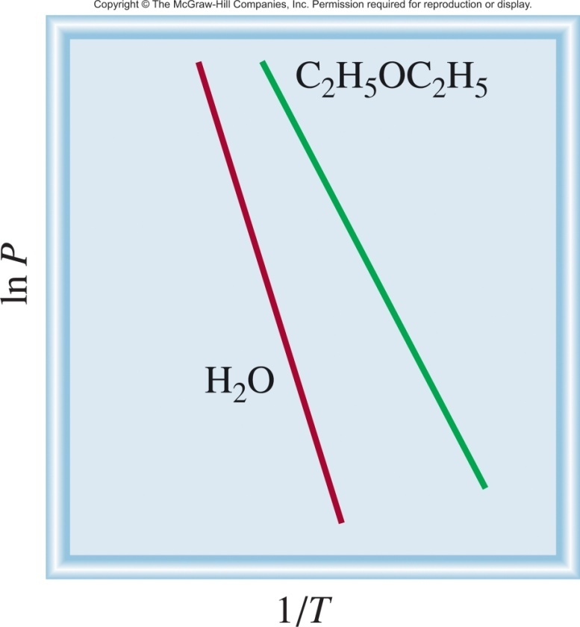
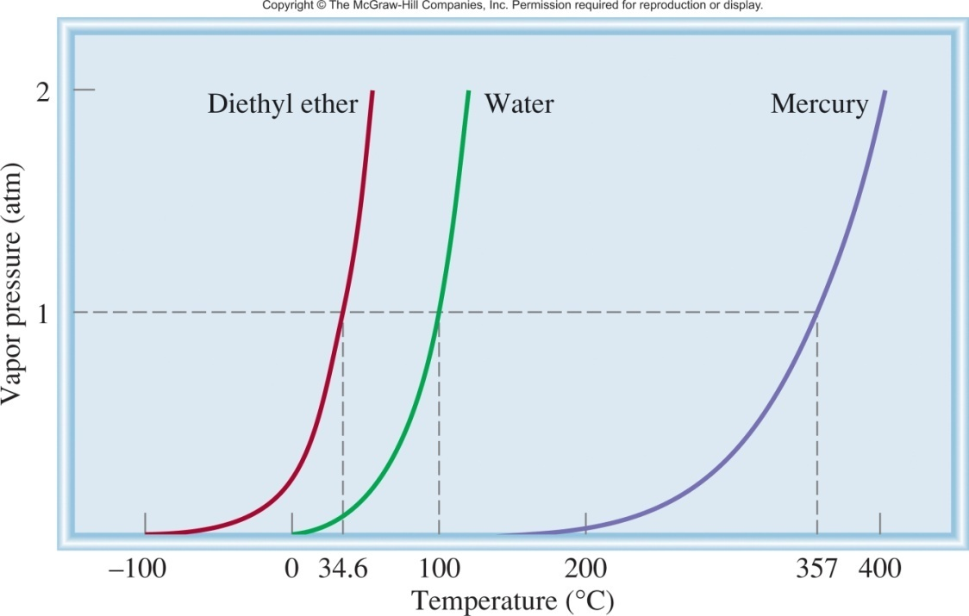
Relationship Between T and P
P = vapor pressure (atm)
y = m • x + b
T = temperature (K)
ΔH_{vap}
1
R = gas constant (8.314 J/K•mol)
ln P =
-
•
+ C
ΔH_{vap} = molar heat of vaporization (J/mol)
R
T
Clausius-Clapeyron Equation

Slide 32
Relationship Between T and P
Clausius-Clapeyron Equation
ΔH_{vap}
1
ln P =
-
•
+ C
R
T
P = vapor pressure (atm)
T = temperature (K)
R = gas constant (8.314 J/K•mol)
ΔH_{vap} = molar heat of vaporization (J/mol)
Molar heat of vaporization (ΔH_{vap}) is the energy required to vaporize 1 mole of a liquid at its boiling point.
Dependent on the substance and its intermolecular forces.
more intermolecular force = larger ΔH_{vap}
Independent of temperature.

Slide 33
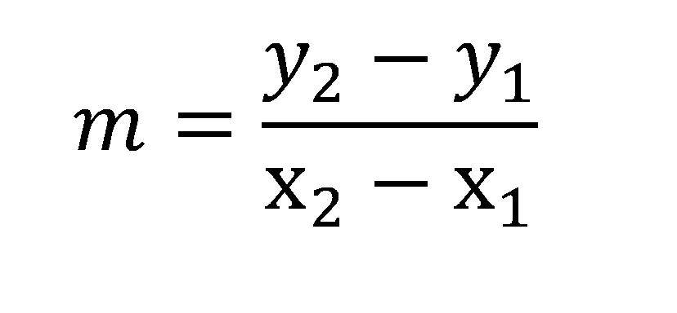
Relationship Between T and P
Alternate Forms of the Clausius-Clapeyron Equation
Slope = change in y/the change in x
or
If we know ΔH_{vap}, P and T at one temperature we can predict P at another T.
or T (bp) at another P.

Slide 34
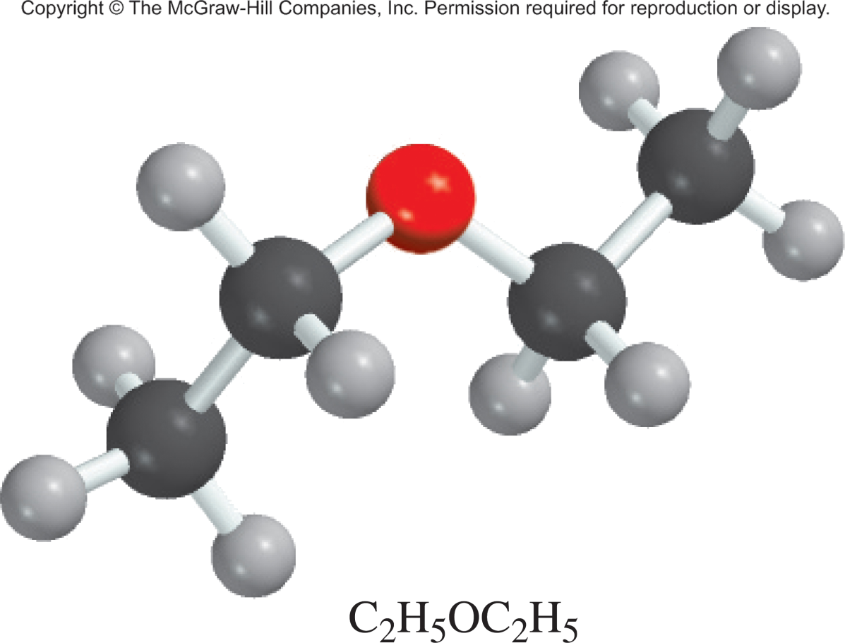
11.7
Diethyl ether is a volatile, highly flammable organic liquid that is used mainly as a solvent.
The vapor pressure of diethyl ether is 401 mmHg at 18°C and the ΔH_{vap} = 26.0 kJ/mol. Calculate its vapor pressure at 32°C.
P = vapor pressure (atm)
T = temperature (K)
R = gas constant (8.314 J/K•mol)
ΔH_{vap} = molar heat of vaporization (J/mol)

Slide 35
11.7
Solution Table 11.6 tells us that ΔH_{vap} = 26.0 kJ/mol. The data are
From Equation (11.5) we have
Taking the antilog of both sides (see Appendix 4), we obtain
P₂ = 656 mmHg
Check We expect the vapor pressure to be greater at the higher temperature. Therefore, the answer is reasonable.

Slide 36
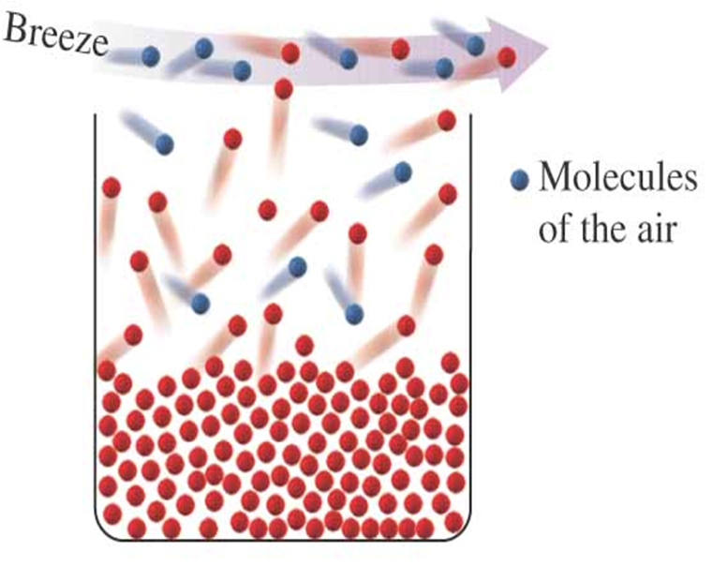
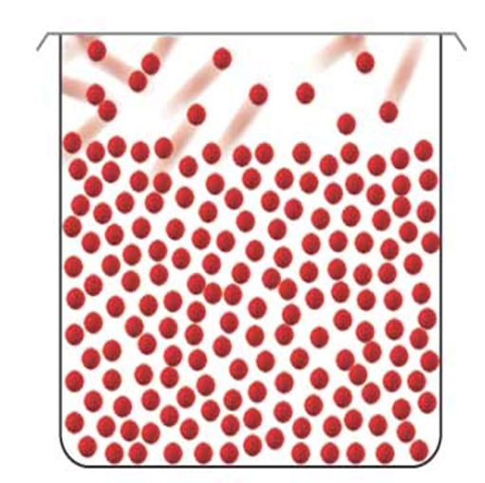
Closed vs. Open Systems
Closed System
Open System
at equilibrium
not at equilibrium
liquid molecules lost

Slide 37
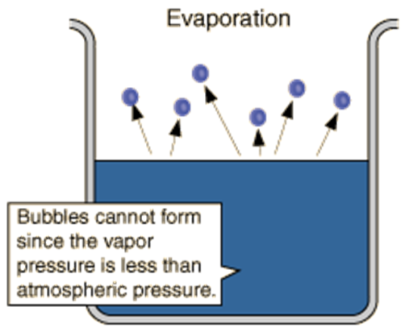
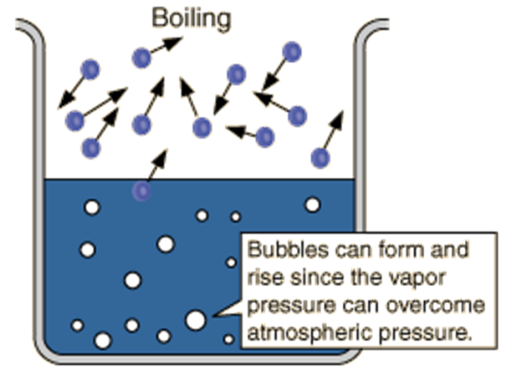
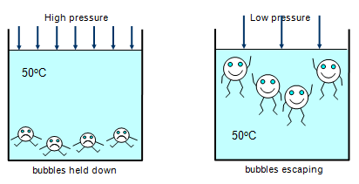
Boiling Point
External pressure
External pressure
Vapor pressure
Vapor pressure
Lower Temp
Higher Temp
vapor pressure < external pressure
vapor pressure > external pressure

Slide 38
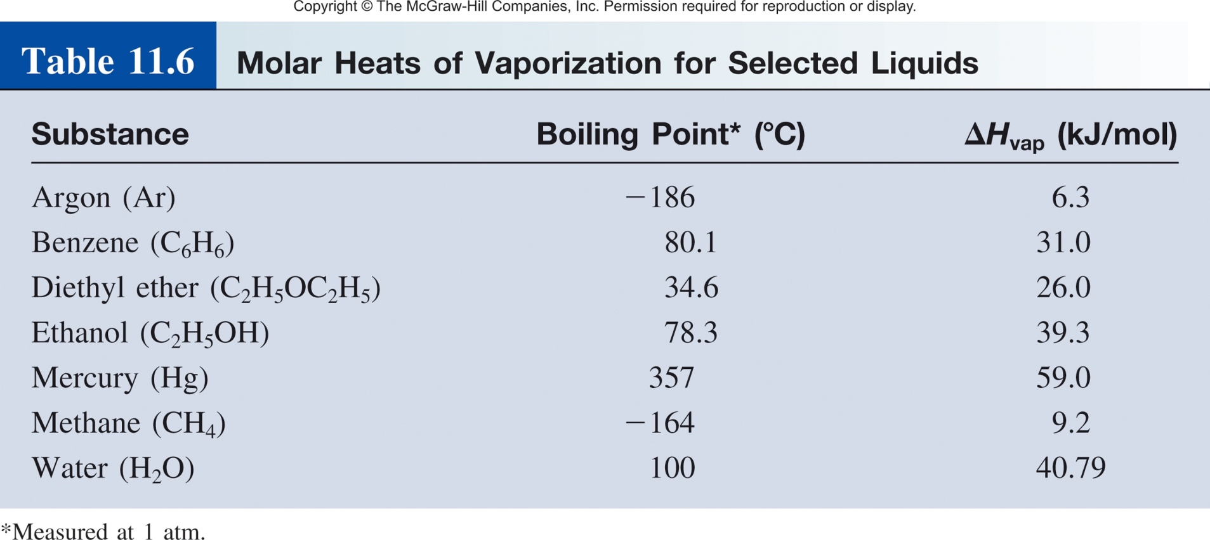
Vapor Pressure and Boiling Point
The boiling point is the temperature at which the liquid’s vapor pressure is equal to the applied external pressure.
The normal boiling point is the boiling point when the pressure is exactly 1 atm.
Decreasing the applied external pressure results in a lower boiling point.

Slide 39
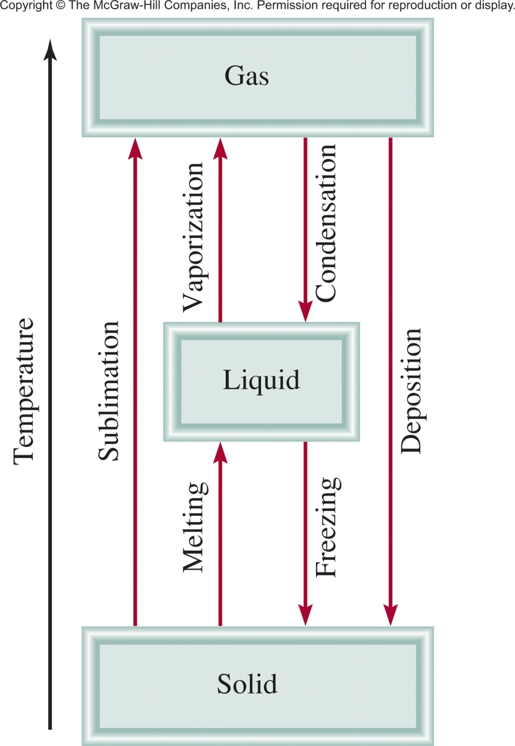
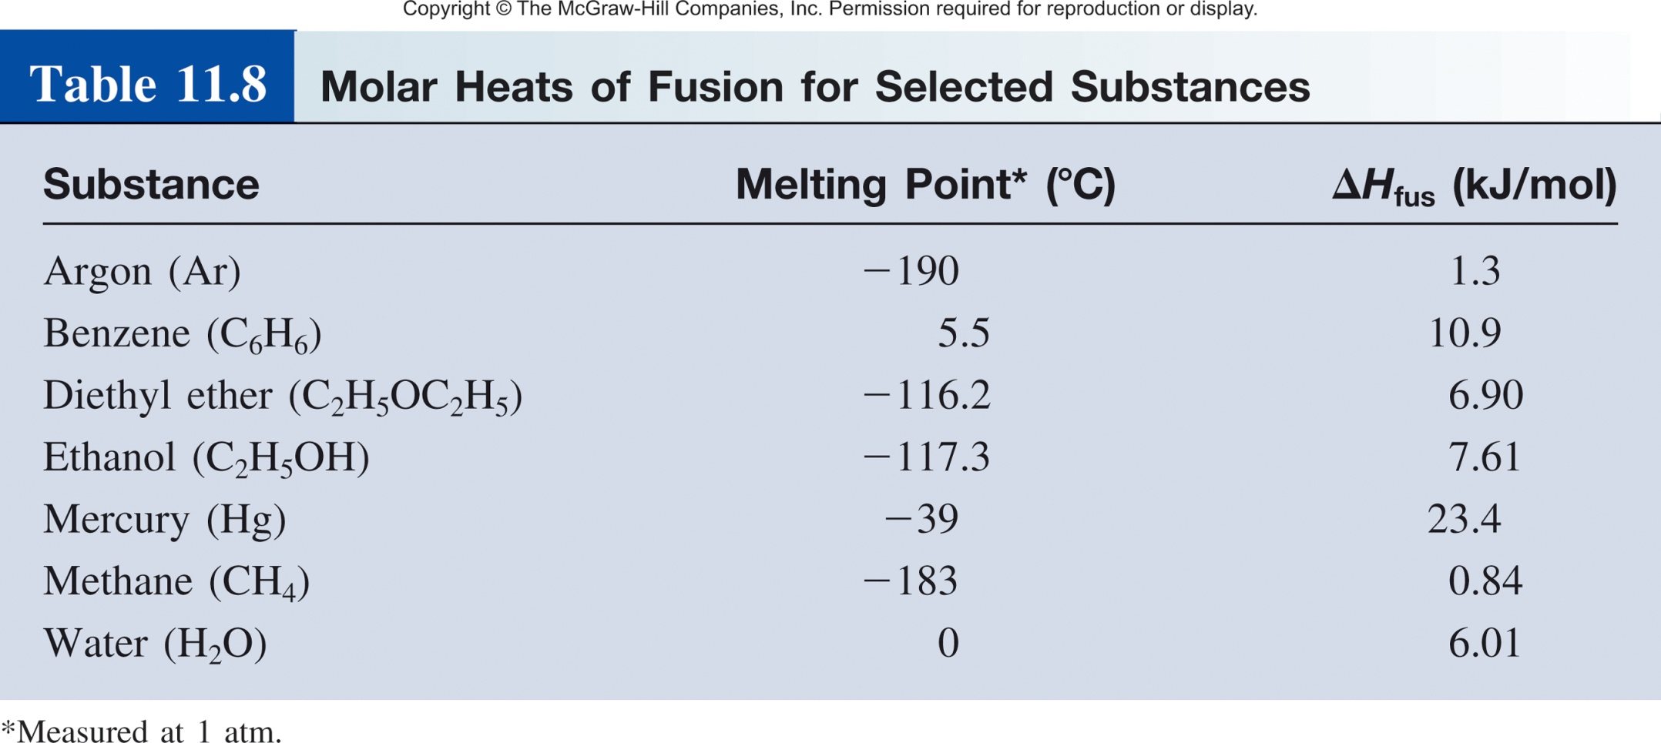
Solid ↔ Liquid
Molar heat of vaporization (ΔH_{vap}) is the energy required to vaporize 1 mole of liquid to gas.
Molar heat of fusion (ΔH_{fus}) is the energy required to melt 1 mole of solid.

Slide 40
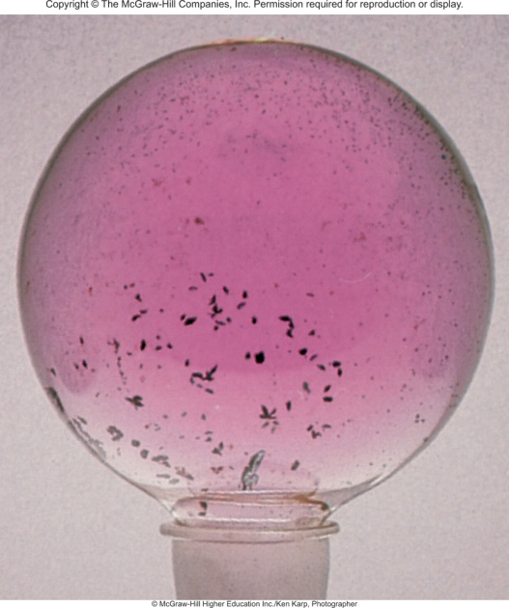
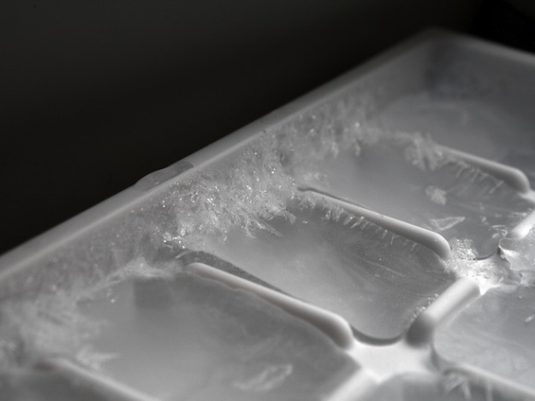
Solid ↔ Gas
Sublimation is the direct transition from the solid to the vapor state “bypassing” the liquid phase
During sublimation the solid and gas phases are in equilibrium
Iodine (I₂)
Ice Cubes

Slide 41
Solid ↔ Gas
Molar heat of vaporization (ΔH_{vap}) is the energy required to vaporize 1 mole of liquid to gas.
Molar heat of fusion (ΔH_{fus}) is the energy required to melt 1 mole of solid.
Molar heat of sublimation (ΔH_{sub}) is the energy required to sublime 1 mole of a solid.
ΔH_{sub =} ΔH_{fus} + ΔH_{vap}
( Hess’s Law)

Slide 42
Phase Change and Heating Curve
Temperature vs. Heat added curve.
The temperature of the substance does not rise during the phase change.
The heat added to the system at the melting and boiling points goes into breaking intermolecular forces.

Slide 44
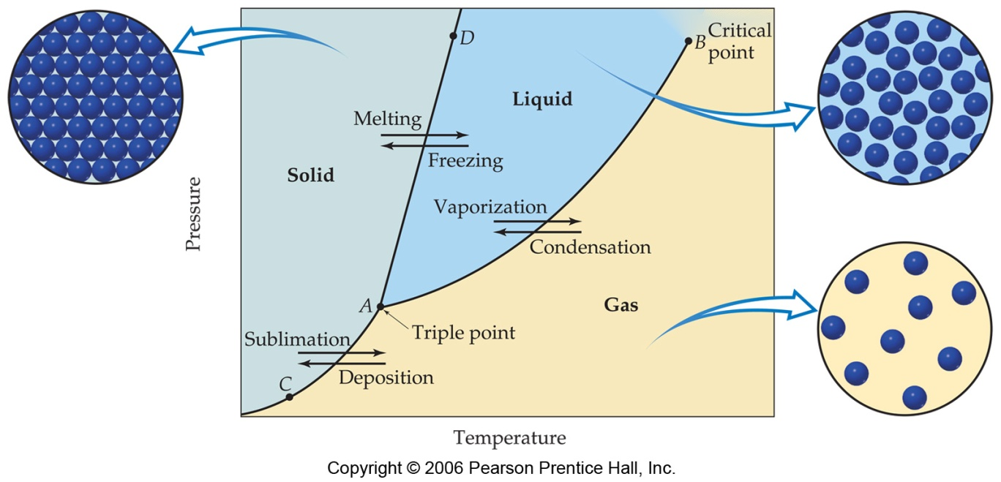
Phase Diagram
A phase diagram summarizes the conditions at which a substance exists as a solid, liquid, or gas and the places where equilibria exist between phases.

Slide 45
Phase Diagram
Important Notes:
Each line (AC, AB, and AD): two phases are in equilibrium.
B) The critical point: above this critical temperature and critical pressure the liquid and vapor are indistinguishable from each other.
Below A: the point below which the substance cannot exist as a liquid .
A) The triple point: the point at which all three states are in equilibrium.

Slide 46
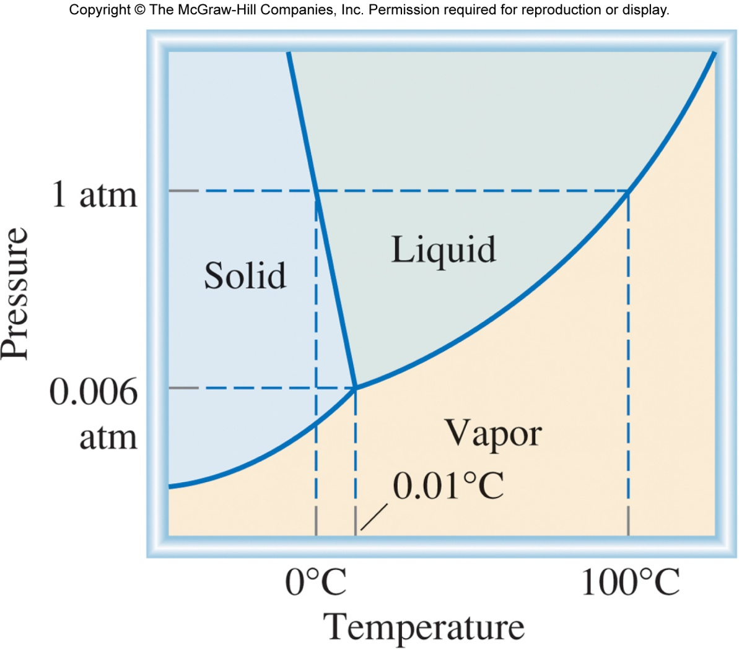
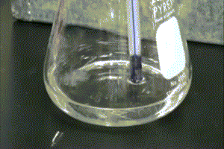
Phase Diagram of Water
Normal melting and boiling points.
Triple Point (0.006 atm and 0.01 °C)
Solid to liquid with applied pressure.
Line slope tell you which phase is more dense.

Slide 47
Actual Phase Diagram of Water
I_{h} phase
I_{c} phase
ICE VII phase

Slide 48
Phase Diagram of Carbon

Slide 49
Phase Diagram of CO₂
What happens if I throw a chunk of solid CO₂ (dry ice) into liquid CO₂?
It will sink.
b) It will Float.
c) Neither.

Slide 50
Phase Diagram Review

Slide 51
Side Note: Supercooling/Superheating
Nucleation site- nucleation site can be thought of as an actual physical location that induces a phase change.
Heating or cooling in the absence of nucleation sites.
Supercooling- is the process of lowering the temperature of a liquid below its freezing point without becoming solid.
Superheating- is the phenomenon in which a liquid is heated to a temperature higher than its boiling point, without boiling.

